Slide 1
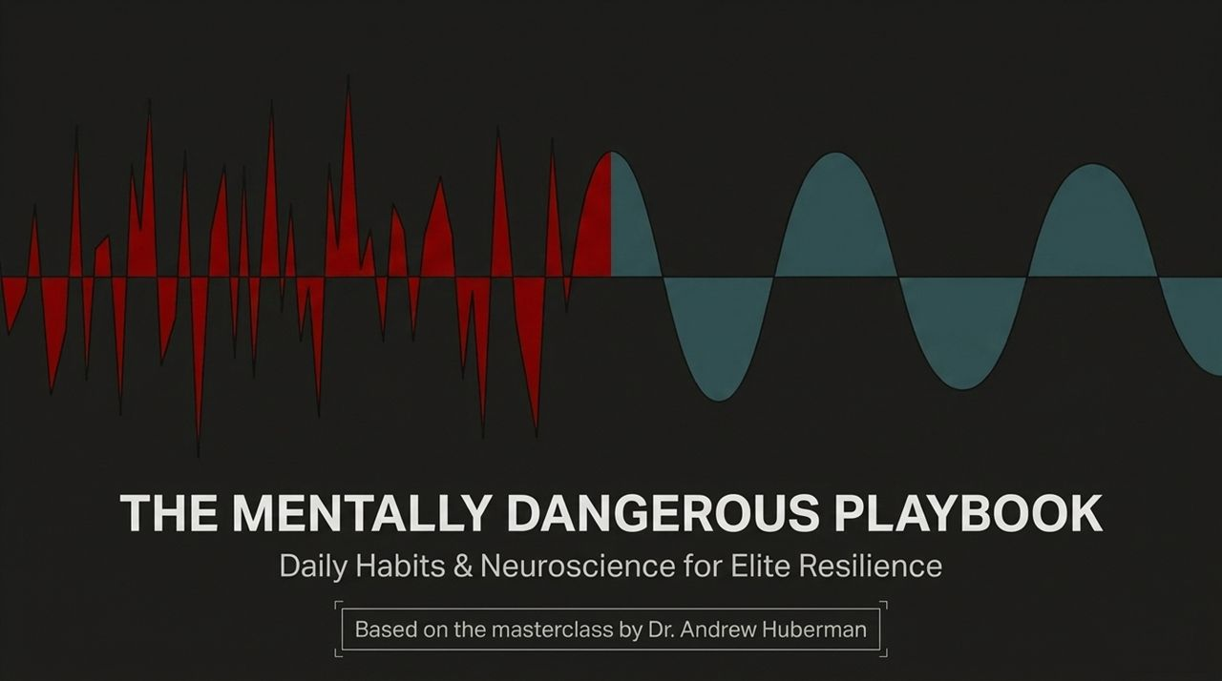
Notes:
Welcome, everyone. Today, we are diving deep into "The Mentally Dangerous Playbook: Daily Habits & Neuroscience for Elite Resilience," derived from the masterclass given by Dr. Andrew Huberman, Professor of Neurobiology at Stanford School of Medicine.
Before we begin, let’s define what we mean by "mentally dangerous." In popular culture, being dangerous often carries a negative connotation. But in the context of high performance, cognitive science, and human potential, being "mentally dangerous" means possessing an unbreakable, unshakeable mindset. It describes an individual who does not collapse under high pressure, who can execute high-stakes decisions without freezing, and who can consciously navigate extreme stress without losing control of their biology.
Many people believe that elite resilience is an innate genetic gift—that you are either born with an iron will or you aren't. Neuroscience proves the exact opposite. Resilience is not a vague psychological trait; it is a mechanical, biological state that can be trained, tuned, and optimized using daily protocols.
Throughout this 16-slide masterclass, we will strip away generic motivation and replace it with hard neurobiology. We will explore how to manipulate your 24-hour endocrine cycle, how to override autonomic panic responses, how to trigger rapid neuroplasticity through deliberate friction, and how to master the art of deliberate recovery.
Whether you are an executive managing high stakes, an athlete pursuing peak performance, or an entrepreneur navigating uncertainty, these protocols are designed to make you sharper, stronger, and harder to stop. Let's begin by exposing the fundamental myth of modern productivity: hustle culture.
https://www.youtube.com/watch?v=Y566_T-YlNQ

Slide 2
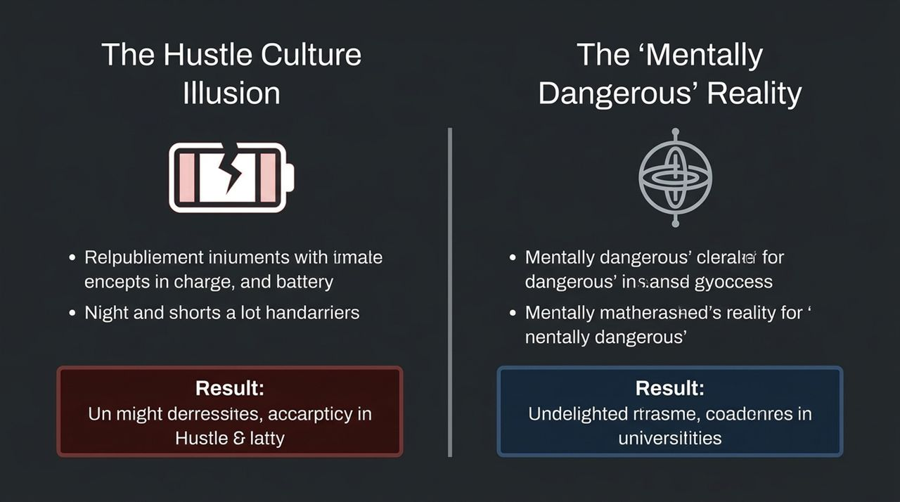
Notes:
Let's look at Slide 2, where we contrast the Hustle Culture Illusion with the Mentally Dangerous Reality.
For the past decade, internet culture has promoted a toxic, biologically illiterate version of success: work 20 hours a day, sleep when you're dead, rely on constant caffeine spikes, ignore your body's strain signals, and run your engine at maximum RPM indefinitely.
What is the biological result of this hustle illusion? It leads to chronic cortisol elevation, disrupted sleep architecture, autoimmune issues, decision fatigue, and eventual burnout. You end up running on fumes—a broken battery attempting to power a high-performance machine.
Now, contrast that with the Mentally Dangerous Reality grounded in neuroscience.
True elite performers—whether SEAL team operators, Stanford neurosurgeons, or elite founders—do not treat their nervous system like a disposable resource. They understand that high performance requires equal mastery over two opposing systems: Activation and Deactivation.
As Dr. Huberman emphasizes, if two equal competitors are locked in high-stakes competition, the individual who can consciously shut their brain off, drop their cortisol at night, and get deep biological recovery will win every single time.
Being mentally dangerous isn't about pushing yourself until you collapse; it's about building an engine capable of generating massive, focused output on demand, and then deliberately gearing that engine down to achieve deep recovery. It is precision biological engineering over brute force.
Let's look at the foundational hormone cycle that dictates this entire mechanism.

Slide 3
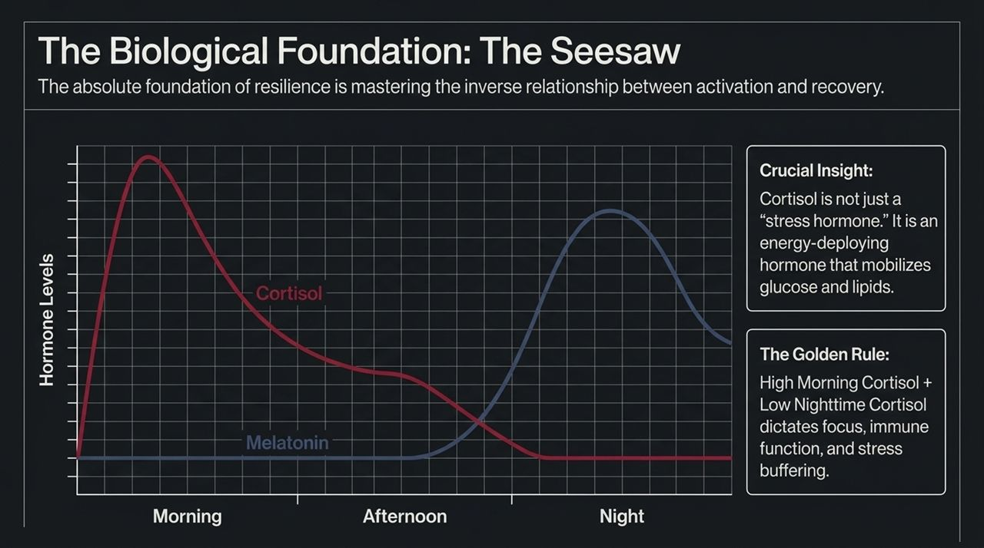
Notes:
Slide 3 illustrates the foundational mechanism of human energy, focus, and resilience: The Hormonal Seesaw between Cortisol and Melatonin.
In popular culture, cortisol is vilified as the "stress hormone." You see articles claiming you should minimize cortisol at all costs. This is a fundamental misunderstanding of human physiology.
Cortisol is not inherently bad; cortisol is an energy-deploying hormone. Its primary biological duty is to mobilize glucose and lipids from storage organs into the bloodstream to power your brain, muscles, and immune system for action. Without a strong cortisol release, you cannot feel alert, focused, or motivated.
The critical biological rule shown on this graph is timing:
In the Morning: You want a steep, rapid spike in cortisol. A high morning cortisol peak sets your circadian clock, elevates daytime body temperature, sharpens cognitive focus, and initiates a timer for melatonin release ~14 to 16 hours later.
At Night: You want cortisol to drop to baseline so that melatonin—the hormone of sleepiness and tissue repair—can rise unimpeded.
Cortisol and melatonin operate like a biological seesaw: when cortisol is high, melatonin is suppressed. When cortisol stays elevated into the evening due to late-night emails, artificial light, or late caffeine, melatonin cannot rise. The result is fragmented sleep, elevated baseline anxiety, and diminished stress buffering the following day.
Mastering your resilience begins by mastering this seesaw: driving cortisol sky-high in the morning and forcing it to baseline at night. Let's look at the exact protocol to achieve that morning spike.

Slide 4
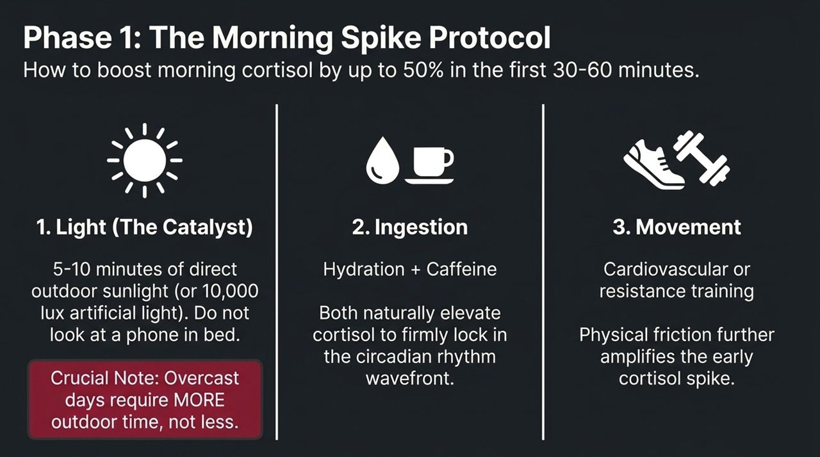
Notes:
Slide 4 details the exact three-part protocol to boost your morning cortisol peak by up to 50% within the first 30 to 60 minutes of waking.
1. Light (The Primary Catalyst):
The single most powerful signal for your brain’s master clock—the suprachiasmatic nucleus—is photons hitting specialized neurons in your eyes called intrinsically photosensitive retinal ganglion cells. Viewing 5 to 10 minutes of direct outdoor sunlight shortly after waking triggers an immediate, healthy spike in morning cortisol.
Crucial Rule: Looking at sunlight through a window pane or glass screen takes 50 times longer to achieve the same neural activation because glass filters out key light wavelengths. Go outside. On overcast or rainy days, you need more time outside (15–20 minutes), not less, because ambient outdoor light on a cloudy day is still far brighter than indoor lighting.
Mistake to Avoid: Do not lie in bed scrolling on a smartphone in the dark. This sends confused, low-lux photons to the brain, stalling your circadian alignment.
2. Ingestion (Hydration + Strategic Caffeine):
When you wake up, you are naturally dehydrated, which elevates resting heart rate and strain. Hydrating immediately with water and electrolytes, paired with caffeine (ideally delayed 60–90 minutes after waking or taken strategically), reinforces the circadian cortisol wavefront.
3. Movement (Physical Friction):
Engaging in light cardiovascular movement, jumping jacks, or resistance work in that first hour introduces physical friction that further amplifies the early cortisol curve.
When you execute this morning protocol consistently, you "entrain" your nervous system. Your brain anticipates the peak, giving you sustainable energy throughout the day without early afternoon crashes. Now, let's look at the opposite side of the seesaw: bringing cortisol down at night.

Slide 5
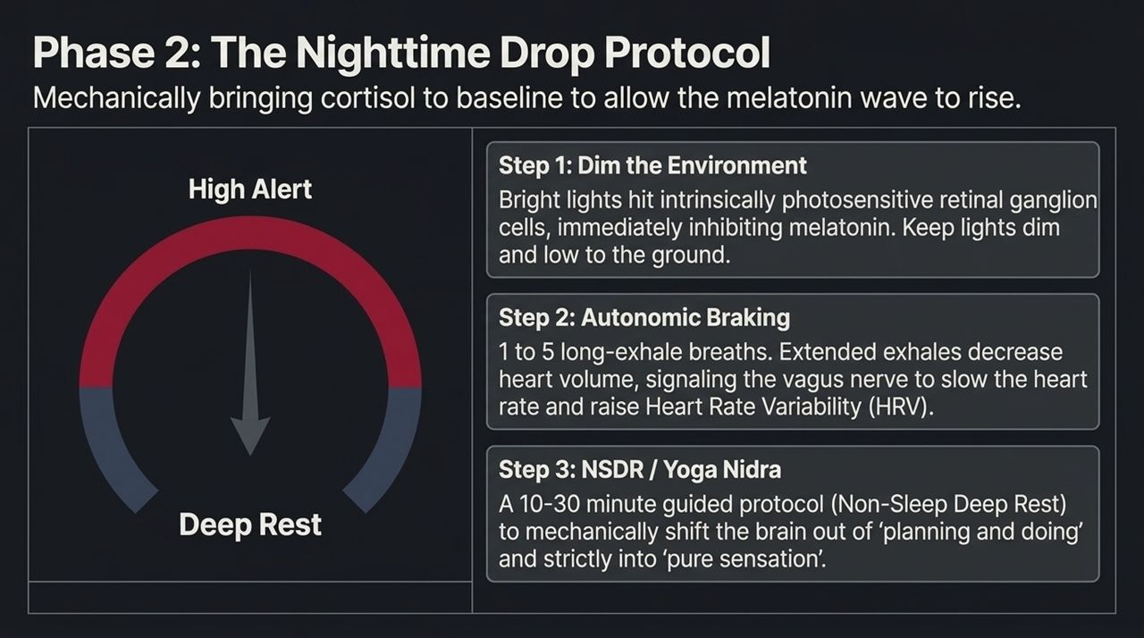
Notes:
Slide 5 outlines the protocol for mechanically bringing evening cortisol down to baseline, unlocking the deep melatonin wave required for restorative sleep.
You cannot simply demand that a high-strung mind "relax" through willpower alone. You must use mechanical leverage on your autonomic nervous system. Here are the three steps:
Step 1: Dim the Environment
In the final 1 to 2 hours before bed, dim bright overhead lights. Overhead artificial lights mimic the position of the noon sun, striking the bottom retina and instantly signaling the brain to suppress melatonin. Shift to low-level, low-lux floor lamps or warm lighting.
Step 2: Autonomic Braking (Extended Exhales)
To manually trigger the parasympathetic (rest-and-digest) nervous system, use extended exhales. When you inhale, your diaphragm moves down, your heart expands, blood flow slows down, and your brain signals the heart to speed up. When you exhale, your diaphragm moves up, heart volume contracts, and the vagus nerve releases acetylcholine to slow your heart rate down. Taking 1 to 5 slow, deep breaths with exhales longer than inhales acts as a mechanical brake on heart rate and stress.
Step 3: NSDR / Yoga Nidra (Non-Sleep Deep Rest)
Engaging in a 10 to 30-minute Non-Sleep Deep Rest (NSDR) or Yoga Nidra session shifts the brain out of active planning, calculation, and beta-wave thinking into alpha and theta brainwave states. It forces the prefrontal cortex to disengage, guiding the mind into pure sensory awareness.
Mastering these steps allows you to reliably turn off your internal engine when the workday ends. But what happens when anxiety hits in the middle of the night? Let's look at Slide 6.

Slide 6
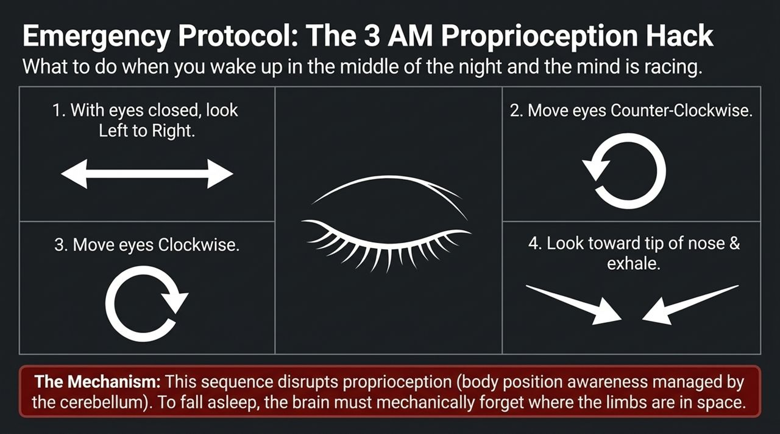
Notes:
We have all experienced waking up at 3:00 AM with a racing mind, playing out scenarios, re-reading emails in our head, and feeling unable to fall back asleep.
On Slide 6, Dr. Huberman reveals a ground-breaking neurological hack that he rarely discusses publicly: The Proprioceptive Eye Sequence.
To understand why this works, we must understand proprioception. Proprioception is your brain’s continuous awareness of where your body and limbs are positioned in space, managed largely by the cerebellum and parietal cortex.
Here is the key insight: To fall asleep, the brain must mechanically forget where the physical body is located in space. As long as your brain is actively tracking limb position and spatial orientation, it remains locked in a subtle state of motor readiness.
When you wake up at 3 AM with a racing mind, execute this precise eye movement protocol with your eyelids closed:
Slowly move your eyes all the way Left to Right.
Rotate your eyes in a slow Counter-Clockwise circle.
Rotate your eyes in a slow Clockwise circle.
Gently point your eyes toward the tip of your nose without straining, and release a long exhale.
Why does this work? This specific lateral and rotational tracking sequence temporarily disrupts proprioceptive feedback loops in the brainstem and cerebellum. It breaks the spatial tracking loop, tricking the brain into believing the physical body has disengaged, which allows the sleep-onset cascade to initiate immediately.
This is a biological tool you can use anytime night anxiety threatens your recovery. Now let's examine cognitive frameworks for managing daytime stress.

Slide 7
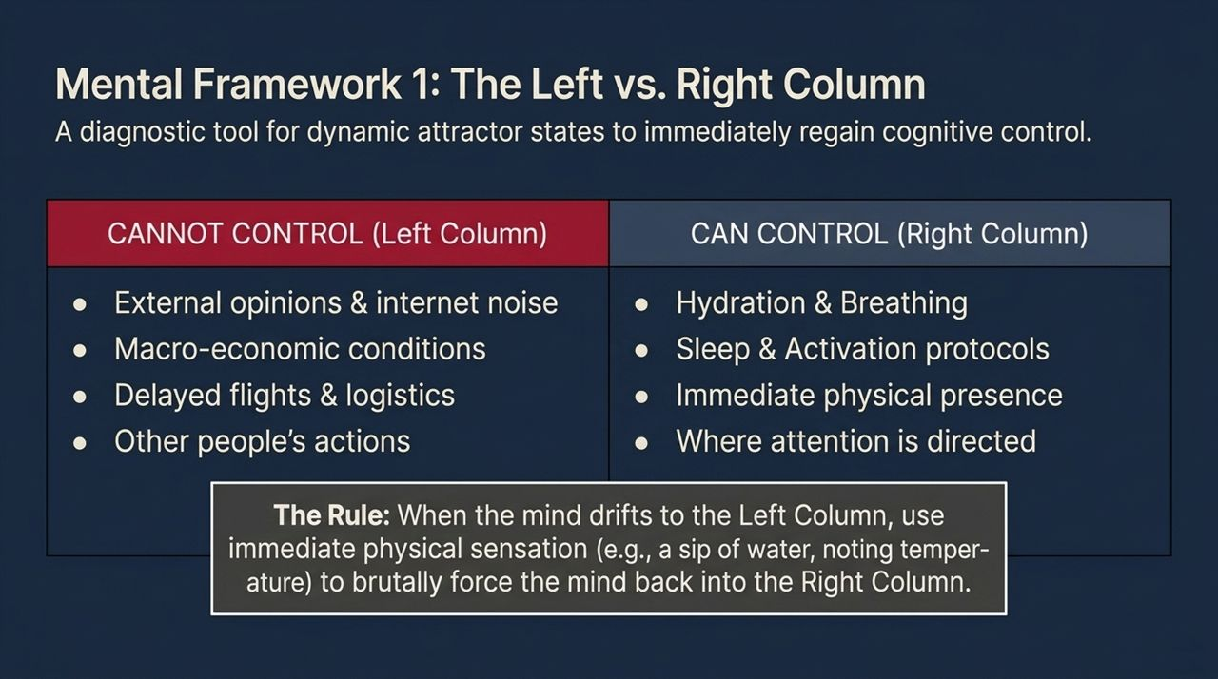
Notes:
Slide 7 presents a diagnostic exercise shared by Dr. Huberman to maintain absolute cognitive control under high stress: The Left vs. Right Column Framework.
Unmanaged stress occurs when the human brain spends excessive energy trying to solve problems over which it has zero mechanical control. When you worry about macro-economic shifts, internet noise, flight delays, or what someone thinks of you, your brain triggers a physiological stress response without any venue for physical action. This creates motor frustration and anxiety.
To fix this, perform this exercise monthly: Take a blank sheet of paper and draw a line down the middle.
The Left Column (CANNOT CONTROL): Write down every external stressor currently cluttering your mind—market conditions, logistics, delayed flights, public opinion, and the actions of others.
The Right Column (CAN CONTROL): Write down actions you can physically execute right now—your hydration, your breathing patterns, your morning light exposure, your work output, and where you direct your immediate attention.
The Operational Rule: Whenever you notice your attention drifting into the Left Column, do not try to argue with your thoughts mentally. Instead, use immediate physical sensation to pull your mind back into the Right Column. Take a sip of cold water, focus on the physical temperature of your hands, or execute 3 long-exhale breaths.
By anchoring yourself exclusively in the Right Column, you eliminate wasted neural bandwidth and channel your energy into actionable output. Let's look at how elite performers process hardship when it strikes.

Slide 8
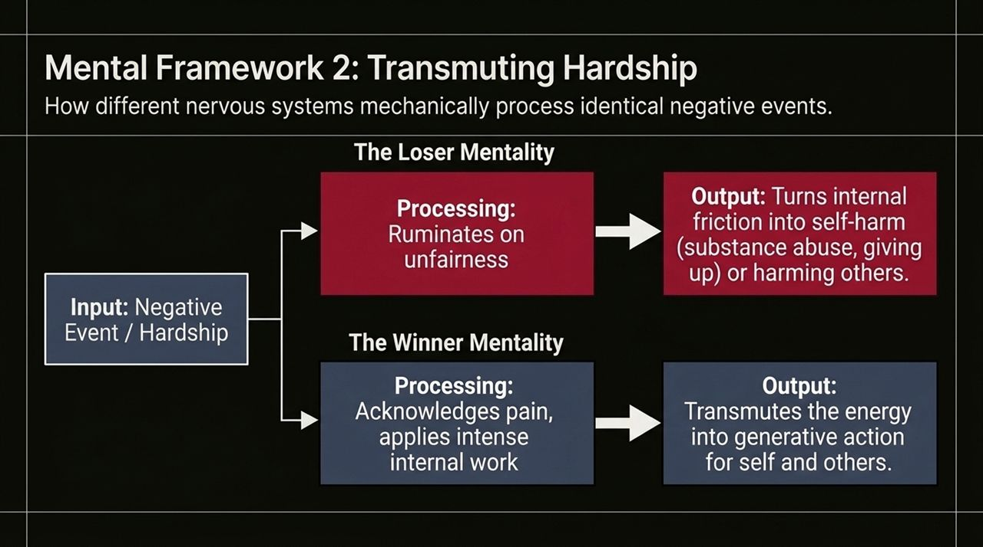
Notes:
Slide 8 illustrates the fundamental difference between how fragile nervous systems and elite nervous systems process hardship and negative events.
Notice that the initial input—a negative event, business setback, betrayal, or injury—is identical for both individuals. Hardship is neutral; its biological impact is determined entirely by how the nervous system processes the internal friction.
Look at The Loser Mentality Processing Path: When negative friction hits, this system fixates on unfairness, external blame, and helplessness. Because energy cannot be destroyed—only transformed—this unchanneled internal friction turns inward, manifesting as self-destructive behavior, substance abuse, chronic cynicism, or quitting entirely.
Now, look at The Winner Mentality Processing Path: When identical friction hits, the elite nervous system acknowledges the pain without denial, but immediately re-frames the internal adrenaline spike as usable energy. It applies intense internal focus to transmute that adrenaline into generative action—channeling the friction into intense work, learning, building, and serving others.
Adrenaline and cortisol are neutral biochemical energy sources. They are fuel molecules designed to drive physical motion. When hardship strikes, a mentally dangerous individual does not ask, "Why is this happening to me?" They ask, "How do I direct this adrenaline into high-value execution?"
Let's look at what happens when the stakes get extremely high and how to prevent choking under pressure.

Slide 9
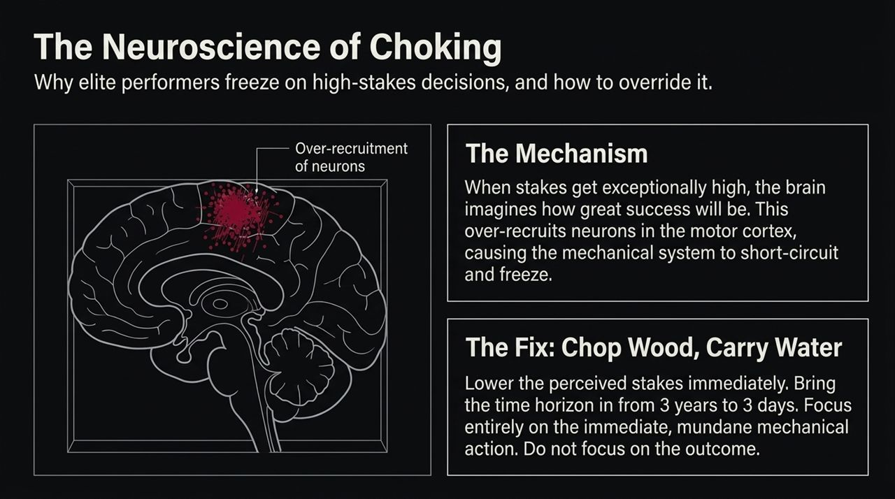
Notes:
We have all seen brilliant individuals—athletes, speakers, executives—freeze or choke when placed in high-stakes environments. On Slide 9, we examine the precise neurobiology of choking and how to override it.
Common sense tells us that people choke because they panic or imagine catastrophic failure. But neuroscience reveals something counterintuitive: Choking often occurs because the brain is over-imagining how incredible success will be.
When the stakes are exceptionally high—a multi-million dollar pitch, a championship match, a public address—the brain focuses on the massive magnitude of the outcome. This causes an over-recruitment of neurons across the motor cortex and prefrontal cortex.
Instead of allowing automated, smooth motor programs to run fluidly, the brain over-analyzes every micro-movement. The neural system short-circuits under hyper-arousal, causing the individual to freeze or blunder.
The Fix: "Chop Wood, Carry Water"
To prevent or break a choke state, you must immediately lower the perceived stakes by shrinking your time horizon:
Do not focus on the 3-year outcome or the grand result.
Shrink your time horizon from 3 years to 3 minutes, or even 3 seconds.
Focus entirely on the immediate, mundane mechanical action in front of you—your next breath, the next slide, the next line of code, or hitting the next ball.
By reducing the task to simple mechanical execution, you reduce cortical over-recruitment, allowing your trained skill set to execute automatically.
Now, let's address a major cultural misconception regarding where true biological growth happens: Clutch vs. Flow.

Slide 10
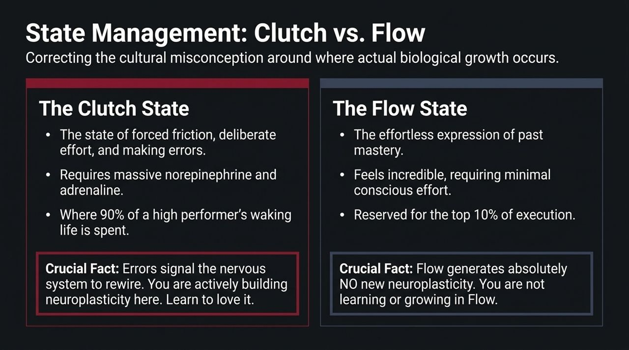
Notes:
Slide 10 clarifies a massive misconception in performance psychology regarding The Clutch State versus The Flow State.
Modern self-help culture is obsessed with "Flow." We are told that elite performance should feel effortless, harmonious, and pleasant. But here is the biological truth: Flow state generates zero new neuroplasticity.
Let's look at the distinction:
1. The Flow State:
Flow is the effortless expression of past mastery. It occurs when you perform a task you have already mastered. It feels incredible and requires minimal conscious effort. However, because there is no friction or frustration, the brain releases no norepinephrine or acetylcholine—meaning no neural pathways are modified. You are not learning or growing when you are in Flow.
2. The Clutch State:
The Clutch state is where true neuroplasticity occurs. It is characterized by forced friction, deliberate effort, intense agitation, and making errors. When you attempt something at the absolute limit of your capability and make mistakes, your brain releases norepinephrine (for alertness) and acetylcholine (to mark specific neural synapses). That feeling of mental frustration and agitation is the literal chemical signal that your nervous system is rewiring itself for growth.
High performers spend 90% of their waking life operating in the Clutch state—embracing friction and error—so that they can effortlessly execute in Flow during the critical 10%.
If you want to build an unbreakable mind, stop avoiding agitation. Agitation is the biological gateway to growth.

Slide 11
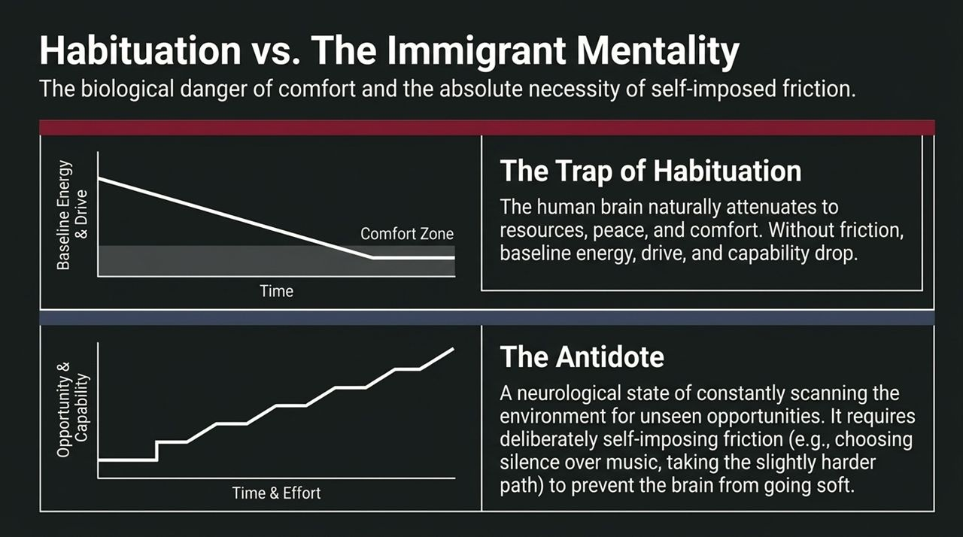
Notes:
Slide 11 examines the biological danger of comfort and why elite performers deliberately preserve what Dr. Huberman calls The Immigrant Mentality.
The human brain is an efficiency engine governed by habituation. When an environment becomes comfortable, safe, predictable, and abundant, the brain naturally attenuates its dopamine and baseline drive. Without friction, baseline drive drops, capability stagnates, and the nervous system goes soft. You see this pattern constantly: individuals achieve success, settle into comfort, and lose the drive that made them successful in the first place.
Look at the graph on Slide 11: as comfort increases, baseline drive and capability naturally decline unless actively counteracted.
The Antidote: Self-Imposed Friction
To prevent biological habituation, you must deliberately inject voluntary friction into your daily life—emulating "The Immigrant Mentality."
This mentality is characterized by a neurological state of constant scanning for opportunity, coupled with an relentless willingness to do hard things.
How do you cultivate this mechanically?
Choose the harder path in small daily tasks.
Drive in silence instead of listening to distracting podcasts or music.
Take cold showers or engage in intense physical exertion when you don't feel like it.
Deliberately seek out environments where you are the least experienced person in the room.
By deliberately introducing voluntary friction, you keep your neural circuits primed, sharp, and hungry regardless of your level of external success. Let's look at a concrete physical protocol to train this exact circuit.

Slide 12
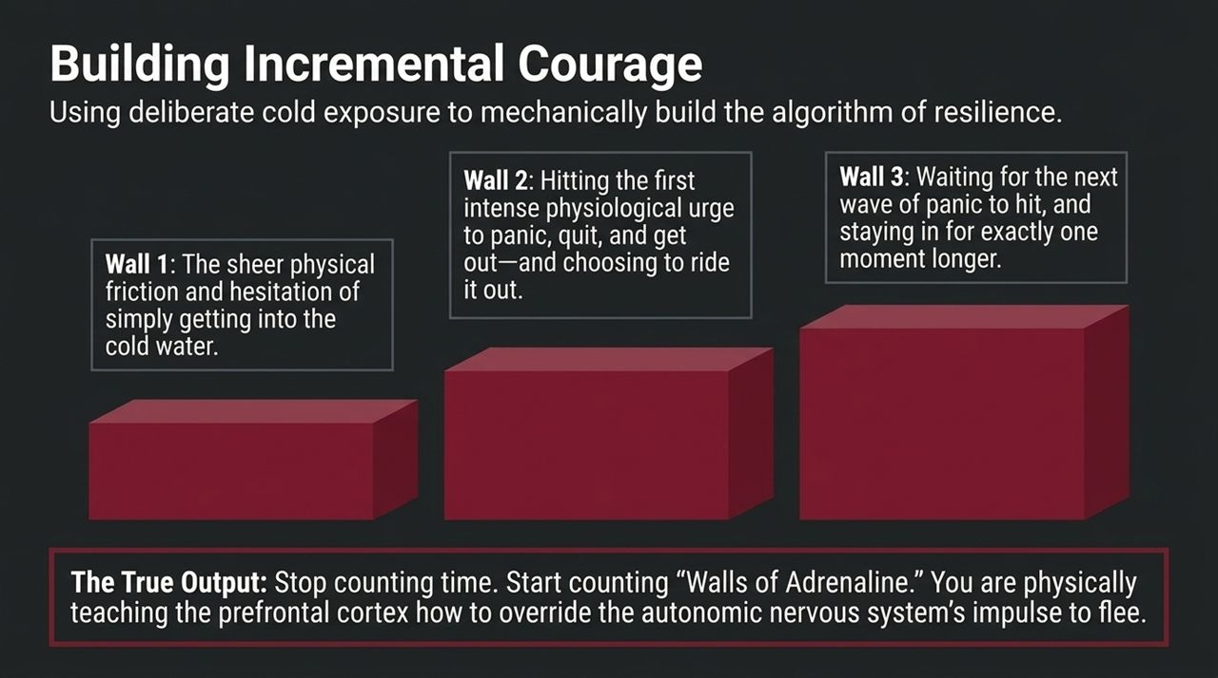
Notes:
Slide 12 details how to use deliberate cold exposure not for muscle recovery, but as a direct neurobiological gym for building unshakable courage and stress resilience.
When most people do cold plunges, they focus on physical duration—staying in for 2 minutes or 5 minutes while staring at a timer. This misses the entire psychological benefit.
Courage is not built by enduring time; courage is built by deliberately overriding walls of adrenaline.
When you step into freezing water, your sympathetic nervous system experiences three distinct biological walls:
Wall 1 (The Hesitation Barrier): The initial physical friction and mental resistance before entering the water. Pushing past Wall 1 trains the prefrontal cortex to override top-down hesitation.
Wall 2 (The Shock Phase): Hitting the intense physiological gasp reflex and the urge to panic, quit, and jump out. Choosing to stay calm, control your exhale, and ride out Wall 2 teaches your brain that agitation is just a sensation, not an emergency.
Wall 3 (The Second Surge): Waiting for the second wave of adrenaline to hit 60 seconds later, and choosing to stay for just one moment longer.
The Key Output: Stop counting time in the cold. Start counting "Walls of Adrenaline." Every time you consciously override a impulse to flee, you expand the size and density of your anterior mid-cingulate cortex (aMCC)—the brain structure responsible for willpower, tenacity, and the drive to live.
Now, let's zoom out and look at how to sustain this level of performance across a 10-year decade.

Slide 13
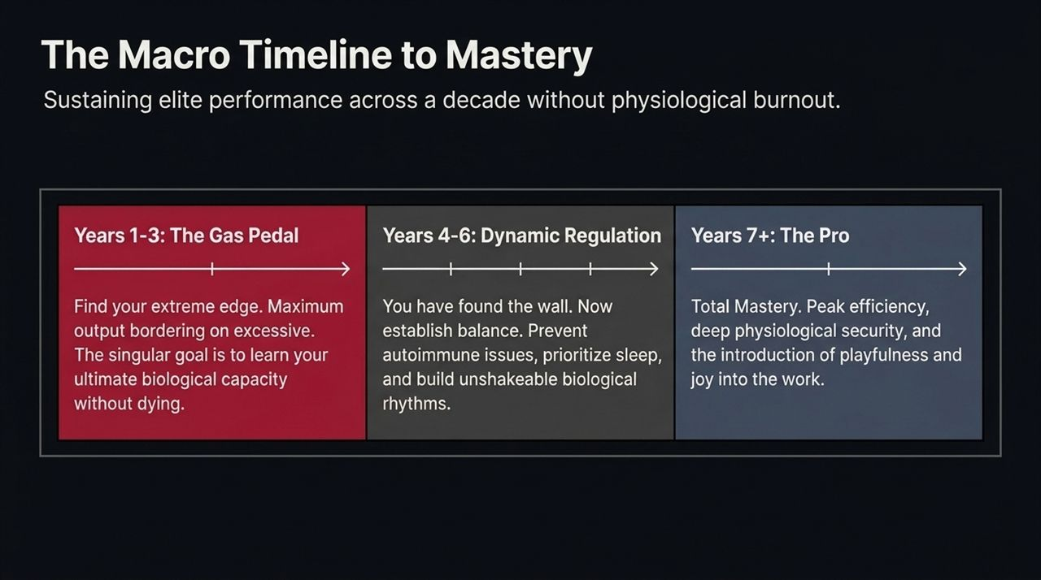
Notes:
Slide 13 outlines the macro timeline required to sustain elite performance across a decade without suffering biological burnout or autoimmune collapse.
High performance is a multi-year career trajectory. Dr. Huberman breaks down a 10-year mastery trajectory into three distinct phases:
Years 1–3: The Gas Pedal (Finding the Bound):
In the early stage of any career or pursuit, your primary goal is to find your absolute biological edge. Work output should be intense, near maximum capacity. The goal here is to discover your ultimate capacity for work and stress tolerance without breaking your health. You learn where your physical wall is located.
Years 4–6: Dynamic Regulation (Establishing Balance):
Once you know where your wall is, you transition to dynamic regulation. You cannot keep the gas pedal pinned indefinitely without burning out. In this phase, you prioritize sleep architecture, build unshakeable circadian rhythms, prevent chronic inflammation, and master recovery protocols. You learn how to modulate your effort like a seasoned endurance athlete.
Years 7+: The Pro (Mastery + Playfulness):
In Year 7 and beyond, you achieve total mastery. You operate with extreme efficiency, deep physiological security, and the re-introduction of playfulness and joy into your work. High stakes no longer threaten your identity because your underlying biological foundation is unshakeable.
To play the long game, you must respect the timeline and transition consciously through each phase.

Slide 14
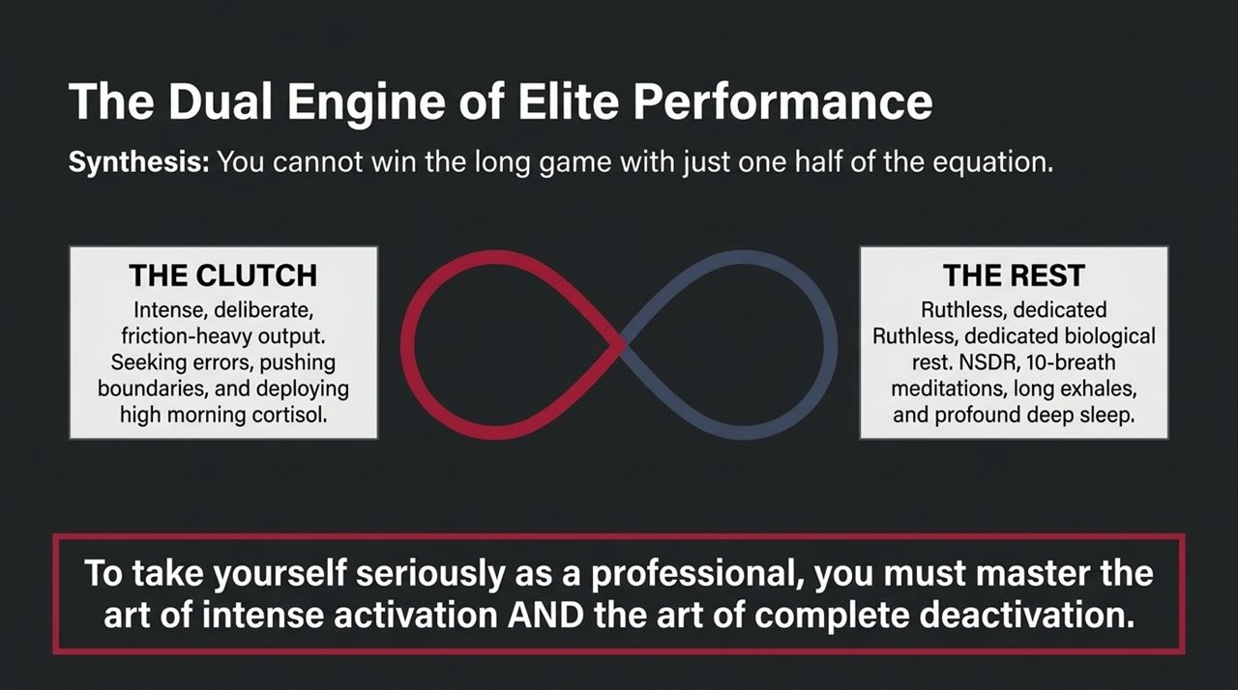
Notes:
Slide 14 synthesizes the entire masterclass into a single, unified framework: The Dual Engine of Elite Performance.
Look at the infinity loop on this slide. You cannot win the long game by operating on only one side of this equation:
Engine 1: THE CLUTCH (High Activation):
This is intense, deliberate, friction-heavy output. It involves seeking out errors, pushing beyond comfort zones, deploying high morning cortisol, and driving hard toward goals. This engine generates progress, skill acquisition, and market dominance.
Engine 2: THE REST (Profound Deactivation):
This is ruthless, dedicated biological rest. It involves NSDR protocols, 10-breath autonomic braking, dimming evening lights, and achieving deep REM and slow-wave sleep. This engine restores cellular health, consolidates memory, and rebuilds neurotransmitters.
The Core Takeaway: As you become more competent and successful in your field, your work creates a deeper inroad into your biological energy reserves. You are building a bigger, more powerful engine.
If you take yourself seriously as a professional, you must take yourself seriously enough to learn how to turn your engine OFF completely.
Mastering activation without mastering deactivation is a recipe for burn-out. Mastering deactivation without activation is a recipe for stagnation. Elite resilience is the seamless, daily oscillation between both.

Slide 15
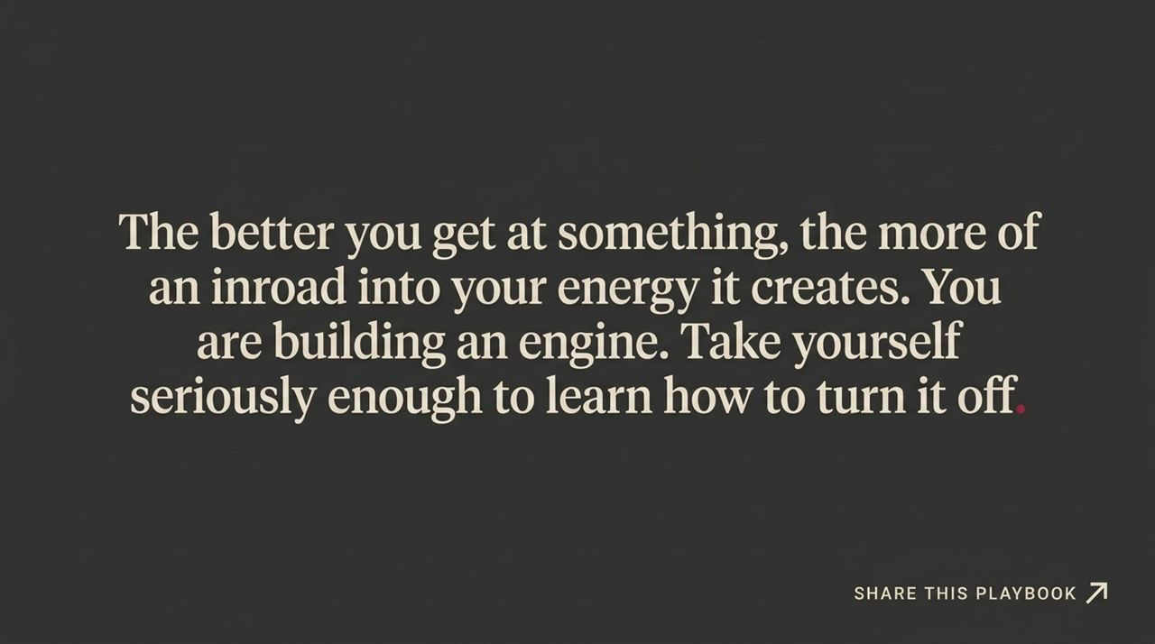
Notes:
Slide 15 serves as your operational blueprint—a quick-reference action summary of the core daily protocols covered in this playbook.
Let's review the daily rhythm:
Morning Light (First 30–60 Min): Get 5 to 10 minutes of direct outdoor sunlight to spike morning cortisol by up to 50%, setting your alertness, mood, and circadian clock for the day.
Evening Light Control: In the final hour before bed, dim all overhead lights to keep cortisol low and allow melatonin to surge naturally.
Master the Clutch State: Embrace daily cognitive friction and agitation as the required chemical signal for neuroplasticity and growth.
Midday Reset (NSDR): Practice 10 to 30 minutes of Non-Sleep Deep Rest to disengage the prefrontal cortex, reduce strain, and restore cognitive energy.
Nighttime Sleep Hack: If waking at 3 AM with a racing mind, execute the proprioceptive eye tracking sequence (Left-Right, Counter-Clockwise, Clockwise, Nose Focus) to disrupt spatial tracking and fall back asleep rapidly.
Print this reference sheet, place it where you see it daily, and turn these science-backed behaviors into automatic habits.

Slide 16
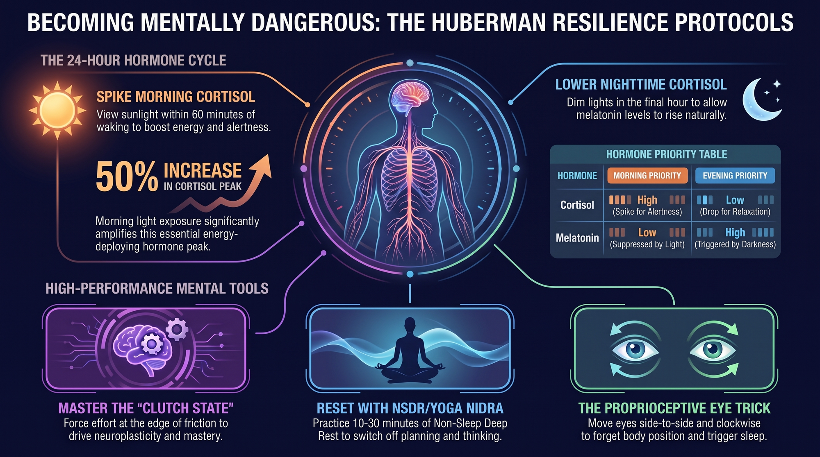
Notes:
Speaker Notes: To conclude our masterclass today, let's review the overarching message of Dr. Andrew Huberman's resilience framework.
Mindset is not an abstract concept that you read about in a book or chant in a affirmation. Your mindset is the downstream reflection of your underlying neurobiology, hormone timing, and autonomic state.
When you master your morning light, respect your evening dimming, embrace friction in the Clutch state, and enforce complete deactivation through deliberate rest, you stop being at the mercy of stress. Stress becomes fuel. Agitation becomes growth. Hardship becomes generative action.
You become adaptable, unshakeable, and impossible to stop—in short, you become mentally dangerous.
Take these protocols, test them in your daily life, measure your results, and share this playbook with those in your network who are striving for elite performance.
Thank you for your time and focus today. I am happy to open the floor to any questions.

